Slide 1
RDBMS and Database Handling
Implementing Joins and Subqueries

Slide 2
Joins

Slide 3
Joins
Is used if we require data from more than one table in the database
Tables are joined on columns that have the same data type and data width in the tables
The JOIN operator specifies how to relate tables in the query
Types of join:
Inner/EquiJoin
Outer join
Self join

Slide 4

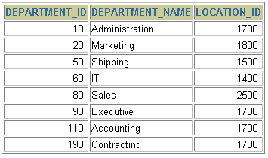



Querying data from multiple tables
EMPLOYEES
DEPARTMENTS

Slide 5
Inner/Equi Join
where statement generally compares two columns from two tables with the equivalence operator “=“
This join returns all rows from both tables where there is a match
Syntax
SELECT <col1>, <col2>,…
FROM <table1>,<table2>
Where <table1>.<col1>=<table2>.<col2>
[AND <condition>] [ORDER BY <col1>, <col2>,…]

Slide 6
Inner/Equi Join
Example : In the table Employee only the numbers of the departments are stored, not their name. For each salesman, we now want to retrieve the name as well as the number and the name of the department where he is working.
SELECT ename, e.deptno, dname
FROM Employee e, Department d
WHERE e.deptno = d.deptno AND job= ‘SALESMAN’;

Slide 7
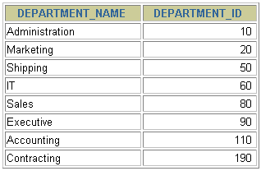
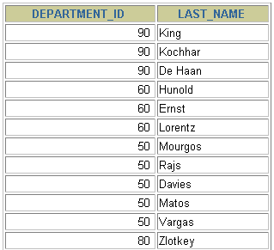
Outer Join
If a row does not satisfy a join condition, then the row will not appear in the query result.
The missing row(s) can be returned if an outer join operator is used in the join condition.
DEPARTMENTS
EMPLOYEES
There are no employees in department 190.

Slide 8
Outer Joins
You use an outer join to also see rows that do not meet the join condition.
The Outer join operator is the plus sign (+).
SELECT table1.column, table2.column
FROM table1 LEFT OUTER JOIN table2
ON table1.column = table2.column;
SELECT table1.column, table2.column
FROM table1 RIGHT OUTER JOIN table2
ON table1.column = table2.column;

Slide 9
Self Join
Two rows from the same table combine to form a result row
It is possible using table labels (aliases) to join a table to itself , as if they were two separate tables
This allows rows in a table to be joined to rows in the same table

Slide 10
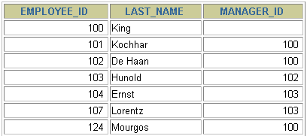
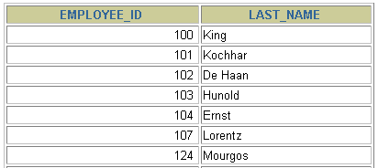
Self Join
MANAGER_ID in the WORKER table is equal to EMPLOYEE_ID in the MANAGER table.

Slide 11
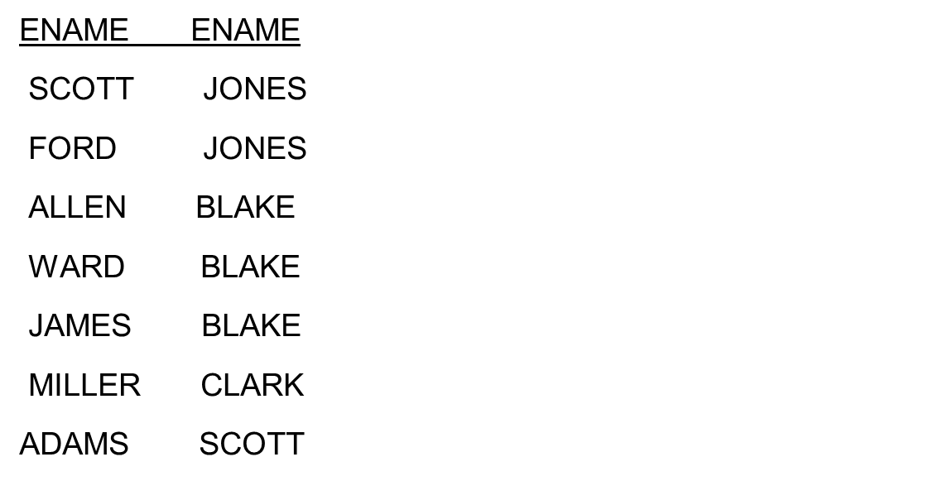
Self Join
Example : List the names of all employees together with the name of
their manager:
SELECT e1.ename, e2.ename FROM Employee e1, Employee e2
WHERE e1.mgr = e2.empno;

Slide 12
Subquery

Slide 13
Querying Data by using Subqueries
Subquery:
Is an SQL statement that is used within another SQL statement.
Is nested inside the WHERE or HAVING clause of the SELECT, INSERT, UPDATE, and DELETE statements.
For example:
SELECT * FROM EmployeeDetails WHERE Designation = (SELECT Designation FROM EmployeeDetails WHERE EmpName = 'John')

Slide 14

Querying Data by using Subqueries
Subquery:
Is an SQL statement that is used within another SQL statement.
Is nested inside the WHERE or HAVING clause of the SELECT, INSERT, UPDATE, and DELETE statements.
For example:
SELECT * FROM EmployeeDetails WHERE Designation = (SELECT Designation FROM EmployeeDetails WHERE EmpName = 'John')
The following figure displays the output of the preceding query.
Represents the subquery and is called an inner query.

Slide 15
Querying Data by using Subqueries
You can specify different kinds of conditions on subqueries by using the following keywords:
IN
EXISTS
IN keyword:
Is used to retrieve rows in a subquery based on the match of values given in a list.
Syntax:
SELECT column, column [,column]FROM table_name WHERE column [ NOT ] IN ( SELECT column FROM table_name [WHERE conditional_expression])
For example:
SELECT EmployeeID FROM HumanResources.EmployeeAddress WHERE AddressID IN (SELECT AddressID FROM Person.Address WHERE City = 'Bothell')

Slide 16
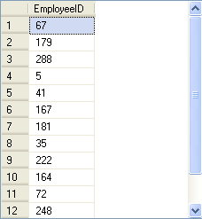
Querying Data by using Subqueries
The following figure displays the output of the preceding query.
Retrieves the EmployeeID attribute of all the employees, who live in Bothell, from the EmployeeAddress table.

Slide 17
Querying Data by using Subqueries
EXISTS keyword:
Is used to check the existence of the data and returns true or false.
Syntax:
SELECT column, column [,column] FROM table_name WHERE EXISTS ( SELECT column FROM table_name [ WHERE conditional_expression] )
For example:
SELECT EmployeeID, Title FROM HumanResources.Employee WHERE EXISTS (SELECT * FROM HumanResources.EmployeeDepartmentHistory WHERE EmployeeID = HumanResources.Employee.EmployeeID AND DepartmentID = 4)

Slide 18
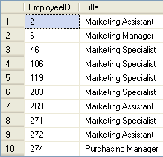
Querying Data by using Subqueries
The following figure displays the output of the preceding query.
Retrieves the employee ID and title of all the employees who have worked in the marketing department at any point of time.

Slide 19
Querying Data by using Subqueries
The ALL keyword:
Returns a TRUE value if all the values that are retrieved by the subquery satisfy the comparison operator.
The ANY keyword:
Returns a TRUE value, if any value that is retrieved by the subquery satisfies the comparison operator.

Slide 20
Querying Data by using Subqueries
The following table shows the operators that can be used with the ALL and ANY keywords.
Operator | Description
>ALL | Means greater than the maximum value in the list. The expression | column_name >ALL (10, 20, 30) means ‘greater than 30’
>ANY | Means greater than the minimum value in the list. The expression | column_name >ANY (10, 20, 30) means ‘greater than 10’
=ANY | Means any of the values in the list. It acts in the same way as the IN clause. The expression | column_name =ANY (10, 20, 30) means ‘equal to either 10 or 20 or 30’
<>ANY | Means not equal to any value in the list. The expression | column_name <>ANY (10, 20, 30) means ‘not equal to 10 or 20 or 30’
<>ALL | Means not equal to all the values in the list. It acts in the same way as the NOT IN clause. The expression | column_name <>ALL (10, 20, 30) means ‘not equal to 10 and 20 and 30’

Slide 21
Querying Data by using Subqueries
The following query displays the employee ID and the title of all the employees whose vacation hours are more than the vacation hours of employees designated as Recruiter:
SELECT EmployeeID, Title
FROM HumanResources.Employee
WHERE VacationHours >ALL (SELECT VacationHours
FROM HumanResources.Employee WHERE Title
= 'Recruiter')

Slide 22
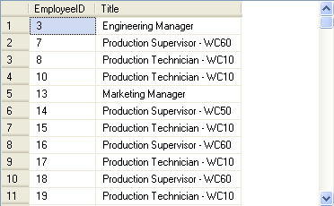
Querying Data by using Subqueries
The following figure displays the output of the preceding query.

Slide 23
Querying Data by using Subqueries
Aggregate functions:
Can be used to generate aggregate values from the inner query.
For example:
SELECT EmployeeId FROM HumanResources.Employee
WHERE VacationHours >(SELECT AVG(VacationHours) FROM HumanResources.Employee
WHERE Title = 'Marketing Assistant')
The inner query returns the average vacation hours of all the employees who are titled as Marketing Assistant.

Slide 24
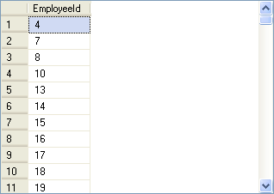
Querying Data by using Subqueries
The following figure displays the output of the preceding query.

Slide 25
Querying Data by using Subqueries
Nested subqueries:
Contain one or more subqueries.
Can be used when the condition of a query is dependent on the result of another query.
For example:
SELECT DepartmentID FROM HumanResources.EmployeeDepartmentHistory
WHERE EmployeeID =
(SELECT EmployeeID FROM HumanResources.Employee
WHERE ContactID =
(SELECT ContactID FROM Person.Contact WHERE EmailAddress = 'taylor0@adventure-works.com')
)

Slide 26
Querying Data by using Subqueries
Correlated subqueries:
Can be defined as a query that depends on the outer query for its evaluation.
Uses the WHERE clause to refer to the table specified in the FROM clause.
For example:
SELECT * FROM EmployeeDetails e
WHERE Salary = (SELECT max(Salary) FROM EmployeeDetails WHERE DeptNo = e.DeptNo)

Slide 27

Querying Data by using Subqueries
The preceding query will display the employees who earn the highest salary in their department, as shown in the following figure.

Slide 28
Summary
In this session, you learned that:
The IN clause in a subquery returns zero or more values.
The EXISTS clause in a subquery returns data in terms of a TRUE or FALSE value.
The ALL and ANY keywords are used in a subquery to modify the existing comparison operator.
Aggregate functions can also be used in subqueries to generate aggregated values from the inner query.
Subqueries that contain one or more queries are specified as nested subqueries.
A correlated subquery can be defined as a query that depends on the outer query for its evaluation.

